Slide 1
Invoice Finance Working Group – Activity Report
Presented by: Arthur PAIJENS
Date: March 26, 2026

Slide 2
About the Working Group
Purpose
The GENA Invoice Finance Working Group (IFWG) was formed to explore and make recommendations concerning the topic of invoice finance, which represents an opportunity for GENA members and the GENA community to derive new sources of revenue and value.
This activity builds on the value created by e-invoicing and supply chain automation and offers those wishing to raise finance or offer such finance an attractive ‘go-to-market’ model based on digitization, powerful electronic networks and rich sources of data.
The Invoice Finance Working Group has published white papers on Supply Chain Finance and on Payments and meets regularly to follow up on new developments and initiatives in this adjacent space of e-invoicing.

Slide 3
Objectives for 2026 & main activities
Invoice Financing paper updated version : « how can an invoice become a tradable asset » – in progress
    External experts: William Drakos, André Casterman, Ognjen Kurtic
    Cooperation with World Bank / ICC / Finspot DIFO (Digital Invoice Financing Origination) Pilot (Romania, Serbia)
Invoice / payment reconciliation

Slide 4
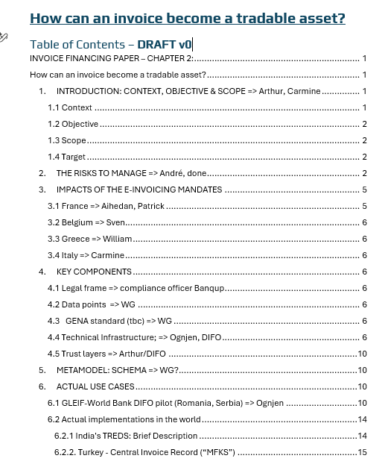
Deliverables 2026
« How can an invoice become a tradable asset ? » paper
V1 before summer

Slide 5

IFWG Meeting (26.03.2026) – Outcomes: AR Flow Building Block
SELLER
INVOICE
BUYER
RESPONSE
PAST OF HISTORY
LIFE CICLE STATUS
ACTORS IDENTITY
Data Quality
Reception
Public\privat
Period
No reject
Proxi System
Others….
Others….
MANDATORY DATA SET
E2E P2P DOCUCMENTS REFERENCES
PAYMENT TERMS
Order ref. number
Order
DETAILS….
Others….
Delivery Notes
Credit Notes

Slide 6
What’s Next ?
Complete the final chapters
Review and harmonize the draft version
Develop a data model
Establish a standard format

Slide 7
How you can help ?
Join the working group!
Suggest ideas to our Chair : email
Attend our upcoming workshop April 16, 10am
Chair
Arthur Paijens
Arthur.paijens@banqup.com
Vice-chair
Carmine Ruopolo
Carmine.ruopolo@tesisquare.com

