Slide 1
Supply Chain Working Group – Activity Report
Presented by: Adam PRINCE
Date: March 26, 2026

Slide 2
About the Working Group
Purpose
The SCWG aims to improve supply chain digitisation by fostering both an understanding of the complex multi-standard infrastructure that exists across financial, tax, logistics, and customs data flows and to promote interoperability, standardisation, and collaboration within these data flows. It seeks to educate members, connect existing standards, and facilitate market growth through integrated digital trade. The group’s objectives include addressing knowledge gaps within these fragmented workflows, enabling seamless data exchange, and supporting sustainability and efficiency in global supply chains for both goods and services.

Slide 3
SCWG – Objectives (= benefits for members)
What are the problems we want to solve?
  Lack of standards & interoperability
  Liaison between Financial/Tax & Logistic/Customs flows
Improve members’ awareness and education on Supply Chain digitisation
  Internal & external expertise
  Explain value & benefits
Facilitate market growth
  Allow faster rollout of supply chain electronic flows
  Generate new business opportunities by connecting flows to support integrated digital trade
Improve collaboration & interoperability of the Supply Chain messages
  B2B exchanges financial & indirect tax flows
  Logistic & customs flows
  Interoperability between financial & logistic flows
  What standards? From point-to-point to 4/5/6 corner model?

Slide 4

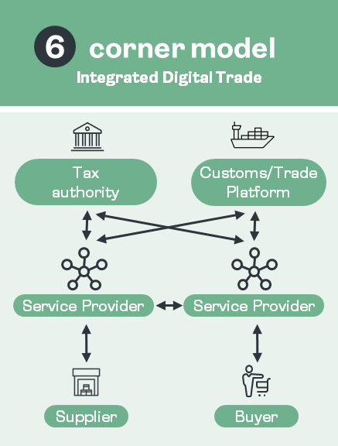
SCWG – Roadmap (still to be discussed)
Define scope 1
  O2C and P2P (same process, 2 sides)
  Direct and indirect spend, goods and services
  Starting with PO (then OR / DN) as it triggers both financial and logistic flows, and covers both goods & services
  Flows diagram
  Link between financial & logistics flows
Education
  Presentations on P2P/O2C, Logistics, Customs flows…
Known barriers & impediments
  Lack of standards
  Discovery issue (where to ?)
  Commercial issues
Liaise with existing organisations and networks
  Existing standards : formats / protocols / networks
  GS1, OpenPeppol, e-FTI, Business networks (Catena X / automotive…)
  E-invoicing & Digital Trade initiative ICC / GENA (just starting)
  Existing initiatives (Italy, Nordics…)
Environmental data
Deliverables ?

Slide 5
Deliverables 2026
Presentation of Peppol Logistics, by Anders Ødegård
Update on digital trade developments
Review of the 7 stage model for Supply chain messages

Slide 6
What’s Next ?
Still to be defined

Slide 7
How can you help ?
Join the working group!
Suggest ideas to our Chair : email
Attend our upcoming workshop April 9, 10am
Chair
Adam Prince
Adam.Prince@sage.com
Vice-chair
Andy Todd
Andy.Dodd@novuna.co.uk

