Slide 1
Interoperability Working Group – Activity Report
Presented by: Michel GILIS
Date: March 26, 2026

Slide 2
AGENDA
Reminder of the IWG’s ambitions
Peppol Vida pilot
GENA Global Directory
GENA Peppol SP2SP domain

Slide 3
About the Working Group
Purpose
One of the primary goals of GENA is to promote and facilitate interoperability.
Interoperability is the ability for businesses to exchange e-invoices and other electronic business documents across networks and service providers.
One of its core missions is:
Advocating for global Interoperability: Enabling seamless digital transactions across borders through standardized and secure solutions built on trusted networks and global standards.
Ambitions
Peppol is now the interoperability framework supported by the GENA community. Our objectives are now:
Monitor: To establish and develop a strategic approach and future direction for GENA’s interoperability frameworks. And make detailed proposals for the development and maintenance of the GENA / Peppol framework.
Inform & coordinate: To fully consult members of GENA & GENA local chapters, other stakeholders and interested parties and liaise with other stakeholders with an interest in interoperability frameworks.
Promote: To provide advice and guidance to GENA Members on the adoption and implementation of the interoperability frameworks.

Slide 4
Objectives for 2026 & main activities
eB2B / SP2SP end of incubation – workstream 1 in progress
    Michel/Ahti + Patrick
GENA Global Meta Directory – workstream 2 in progress
    Michel, Ahti, Henrik, Patrick + Marcus + Dirk, Stefan
CEN TC434 – EN16391 evolution
    Update done by Paul Simons
GENA marketplace task force
Peppol Vida pilot implementation follow-up

Slide 5
Deliverables 2026
GENA Peppol eB2B/SP2SP subcontracting use cases description (with OpenPeppol)
    Detailed for Poland
SP2SP Peppol domain charter (with OpenPeppol)

Slide 6
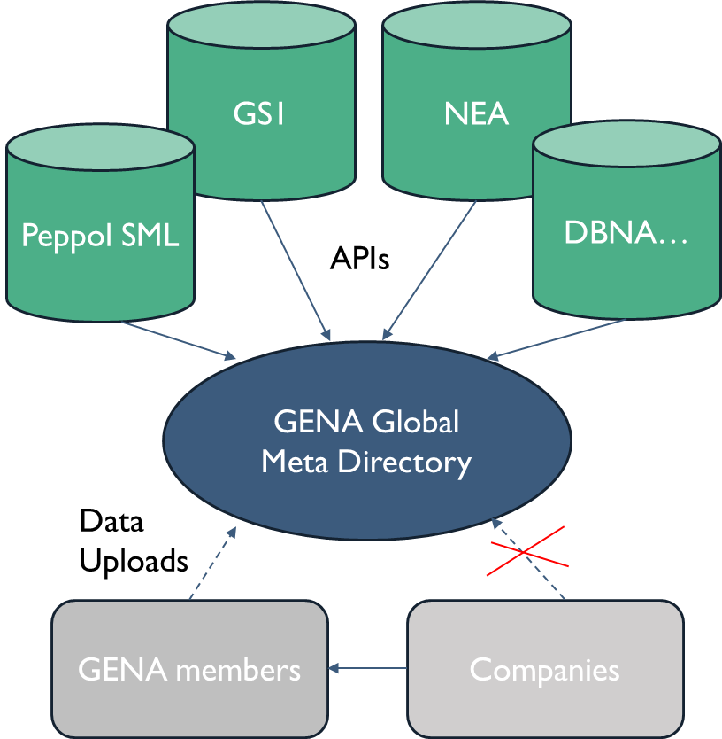
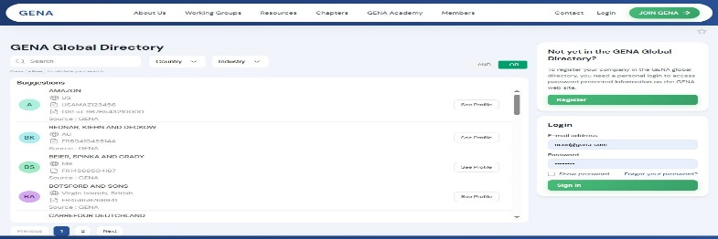
Projects in progress – GENA Global Directory
What?
  A worldwide “telephone book”
  A cross-network discovery framework
  Public url, maintained by GENA
  To enable any company to locate its business partner & know its e-exchange capabilities
Why? Benefits for members
  Interconnects existing directories
  Facilitates onboarding and interoperability
  Brings global visibility to GENA and members
How? The solution
  A meta directory fed by
    Existing networks
    Members uploads
  A GENA white label solution
  Potentially based on the Connecteez solution
    Phase 1 : POC (2026)
    Phase 2 : members’ vote => Production (2027)

Slide 7
Global Global Directory - Discussion topics
Documentation :
  Link to the full presentation :
  Link to the specs :
  Link to the video recording of the demo :
POC content :
    Queries from 3 external directories : Peppol, DBNA, NEA
    Uploads from 5 SPs networks lists (manually or through XML uploads)
    Functional coverage : whole solution
    Geographical focus : tbd
Questions for members :
  Would you be OK to participate in the POC? If not, why?
  Do you see the benefits for members?
  What region should we focus on for the POC : EU, out of EU, cross-border ?
  Any comment on the data model?
  Should we allow the bulk search only for the members who upload their lists? (it will be accessible only to members anyway, unit search only for the public)
GENA IWG - Global Directory workstream - meeting 20260319.pptx
Gena Global Directory Functional specifications v1-PG.docx
DirectoryConnecteezDemo.mp4

Slide 8
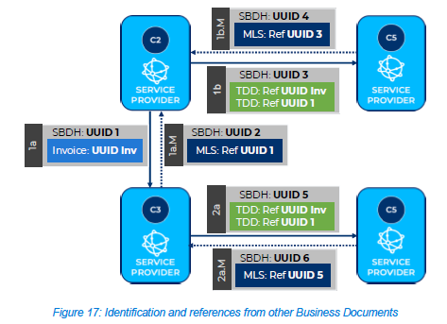
Peppol ViDa pilot: extended – 6 corner eDelivery model
  6 UUID’s
  Invoice
  TDD
  4x transmission
  Discovery participant
  As is
  Discovery MLS x2
  Access Point SchemeID
  AP id
  Discovery TAX admin
  Access Point SchemeID
  AP id
  ‘TaxAuthority’
  country

Slide 9
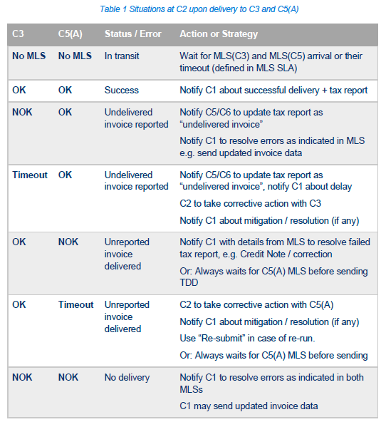
Peppol ViDa pilot: transaction orchestration
  Parallel flows
  Invoice (CreditNote)
  TDD
  MLS status
  OK
  NOK
  Missing
  Invoice flows
  Corrective invoice?
  TDD Flows
  submit
  Re-submit
  Disregard

Slide 10
Peppol ViDa pilot: Open topics
  Security model
  Confidentiality
  Authorizations (KYC, PA, TA)
  Accreditation of service providers
  TDD local jurisdiction
  Monitoring
  C1-2 and C3-C4
  Secure connection (end to end)
  Common API
  TDD local requirements
  PINT wildcard approach?

Slide 11
Other ViDa initiatives: new adventures in a 5-corner world
  Hungary (note on ViDa intentions)
  Move to EN-16931 update 1 profile
  NAV as TAX reporting platform
  Peppol as interop platform (Hungary PA)
  B2C with encryption of personal data
  France
  PPF as TAX reporting platform
  Peppol as interop platform (France PA)
  Peppol credential whitelist
  Complex participant exchanges
  Complex life cycle statuses
  MLS <> Cdar
  Slovakia
  TDD variation
  Peppol as TAX reporting + default interop platform
  Non-Peppol edelivery supported
  Peppol credential issuance (certificates -> delegation) but including non-domestic login (EU Member state login)
  Local SMP

Slide 12
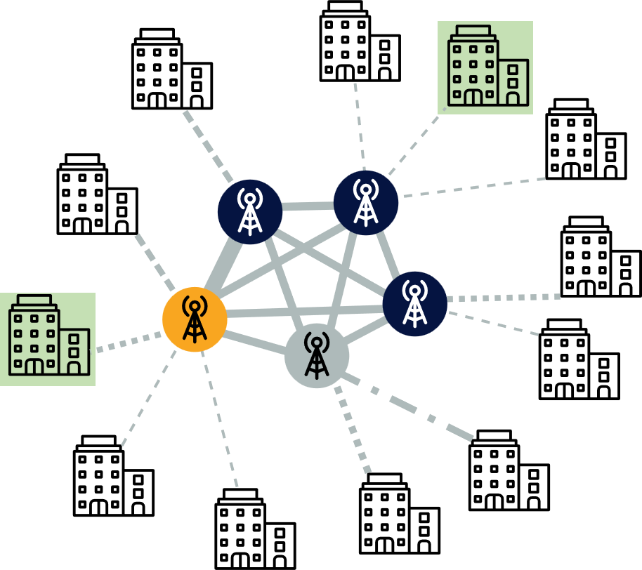


Projects in progress – GENA Peppol SP2SP
« last mile » use case (subcontracting)
What?
  A GENA Peppol interoperability framework
  To address SPs’ requirements not covered by standard Peppol Post-Award domain
Why? Benefits for members
  Business opportunities (new use cases)
    Subcontracting (e.g for local accreditations)
    Bilateral & end-user specifics (e.g retail, auto…)
How? The solution
  Phase 1 : Incubation with 20+ members
  Phase 2 : New SP2SP Peppol Service domain
    GENA + OpenPeppol governance
    SP2SP implementation elements :
      canonical UBL invoice format
      non-XML payloads
      digital annexes (XML attachments)
      tracking (MLS)
      bi-lateral exchanges set-ups
e.g. Local accreditation:
France PDP/PA, UAE, AU/NZ, SG, MY, …, Slovakia
Similar de-centralised networks:
DBNA, Nemhandel, Croatia, …

Slide 13
GENA Peppol SP2SP - Discussion topics
KSef subcontracting use case : feed-back from MySupply
SP2SP as alternative to standard API: French use case
Next steps

Slide 14
What’s Next ?
GENA Peppol SP2SP end of incubation
GENA Global Meta Directory POC implementation (if confirmed)
Peppol ViDA pilot implementation
  If interested, contact vidapilot@peppol.eu
GENA marketplace implementation

Slide 15
How you can help ?
Join the working group!
Suggest ideas to our Chair : email
Attend our upcoming workshop April 30, 10am
Chair
Michel Gilis
mgilis@axway.com
Vice-chair
Ahti Allikas
Ahti.allikas@gep.com

