Slide 1
Innovation Working Group – Activity Report
Presented by: Alex PAVEL
Date: March 26, 2026

Slide 2
About the Working Group
Purpose
Driving the evolution of e-invoicing through artificial intelligence and cross-industry collaboration.
GENA’s Working Group on Innovation brings together leading service providers and experts from around the world to explore, develop, and apply AI technologies that redefine the future of e-invoicing and digital compliance. Our mission is to accelerate innovation, enhance interoperability, and shape global standards by leveraging artificial intelligence across the e-invoicing ecosystem.

Slide 3
About the Working Group
Ambitions
We have several focus areas :
1. Data Standardization and Semantic Interoperability Powered by AI
Harness AI to harmonize e-invoicing data structures across national and industry standards.
Apply machine learning to achieve semantic interoperability between key frameworks (UBL, CII, Peppol BIS, Factur-X, etc.).
Explore automation in cross-format conversion, validation, and mapping—enabling seamless global data exchange.
2. Predictive Analytics and Intelligent Compliance Monitoring
Use AI-driven analytics to detect and predict non-compliance or fraud risks in real time.
Develop predictive models for fiscal management, continuous transaction controls, and Procure-to-Pay optimization.
Enable service providers to dynamically adapt their solutions to evolving regulatory landscapes.
3. Cross-Association Collaboration Strategy
GENA aims to actively pursue collaborative relationships with other trade associations to address shared AI-related challenges in the e-invoicing domain and amplify its impact across the industry.
Identify key partner associations and establish clear contact points to facilitate coordination and information sharing
Develop a structured collaboration framework that defines communication protocols and coordination mechanisms for productive partnerships
Pursue joint initiatives including coordinated research efforts, collaborative standards development, and industry-wide approaches to AI adoption in e-invoicing and tax compliance

Slide 4
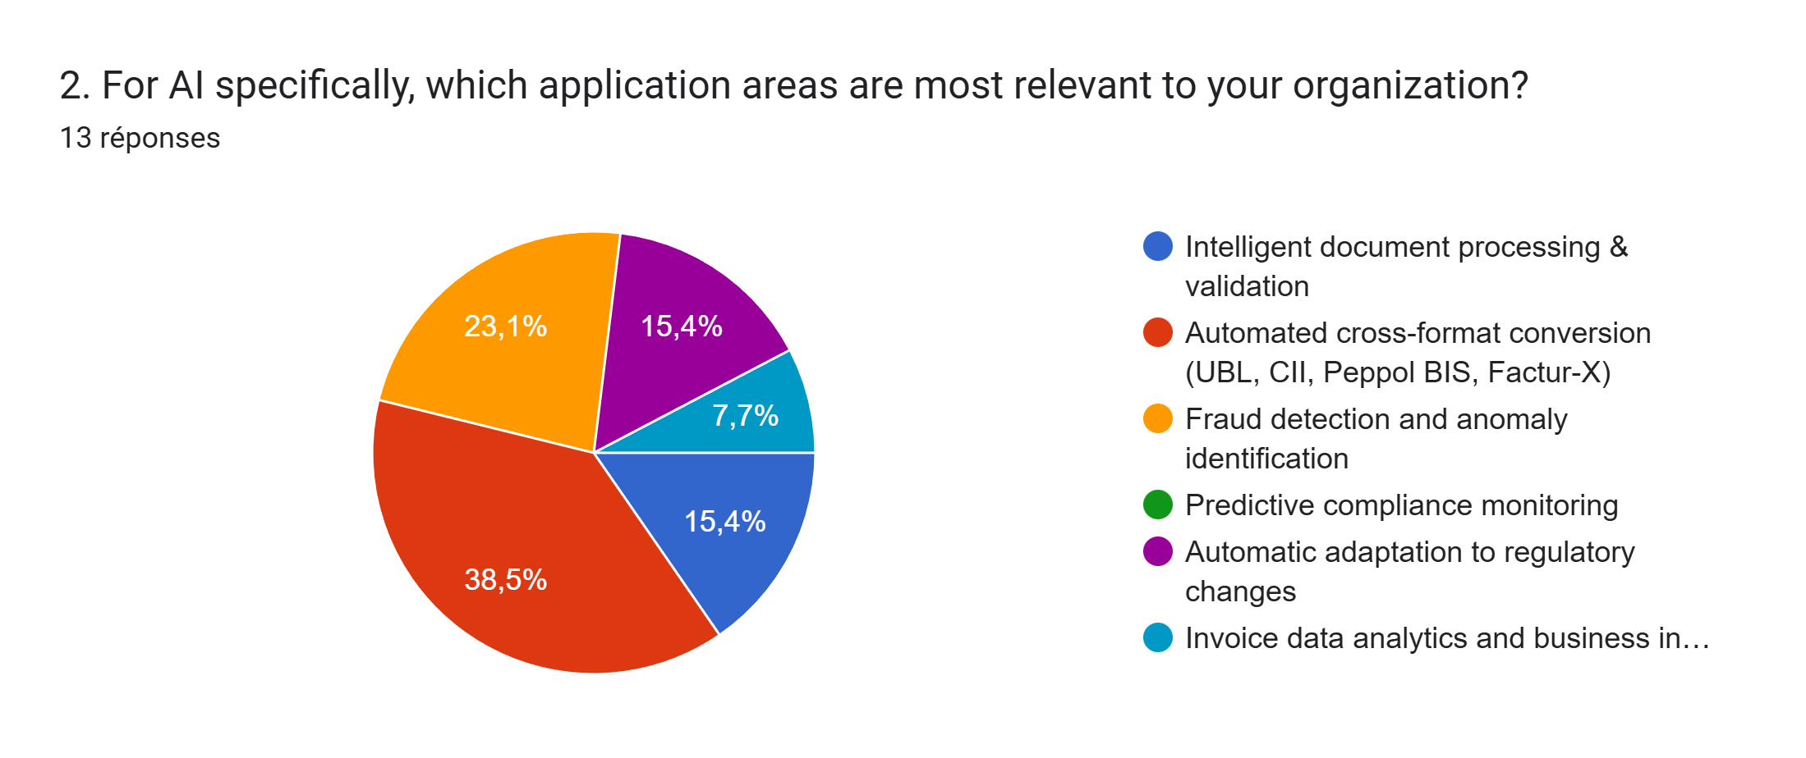
Recent Survey Snapshot

Slide 5
Objectives for 2026 & main activities
Paper on AI in electronic invoicing
Proposed structure of the report :
    Executive summary and context setting
    AI opportunity landscape in e-invoicing
    Member use cases (internal operations and client-facing solutions)
    Industry patterns and emerging trends
    Challenges, risks, and open questions
    Forward-looking perspectives on industry evolution
    Skills and work-related perspective

Slide 6
Member Use Cases – Examples of Themes
How Members Are Applying AI
Examples, organised thematically, revealing industry-wide patterns, not a vendor catalogue
🔍
⚖️
🛡️
Intelligent Data Processing
Compliance & Regulatory Intelligence
Fraud Detection & Risk Scoring
OCR, LLMs for unstructured data, format conversion
Rule engines, mandate monitoring, real-time validation
Anomaly detection across transaction flows
🔄
🤖
📈
Interoperability & Format Translation
Customer-Facing Automation
Predictive Analytics & BI
AI-driven mapping: UBL, CII, Peppol BIS, Factur-X
Copilots, chatbots, exception handling, onboarding
Cash flow forecasting, supplier risk, working capital

Slide 7
Agenda March Meeting (In-Person, 60 min) – Draft, let’s finalize it
Opening & February recap | 5 min
Member Content Sprint | 25 min
  Members have to to come prepared with 2–3 examples on AI in e-Invoicing use cases each. In the room, map them to the six (or more) themes on a shared board, then spend 10 minutes as a group discussing patterns and gaps.
  Which of these use cases are candidates for GENA member collaboration as part of the WG?
Methodology & Capability Index | 10 min
  A pragmatic discussion: how do we handle member coverage, and do we want an index? Decisions, not debate.
Closing & assignments | 15 min
  Who drafts what, publication timeline (internal vs. public), next meeting date.

Slide 8
How can you contribute?
Join the working group!
Suggest ideas to our chairs
Attend our upcoming workshop: April 30, 9am
Chair
Sebastien Vugier
Sebastien.VUGIER@cegedim.com
Chair
Alex Pavel
alex.pavel@sovos.com

